Slide 1

Student 1 - 192CT109 & GOKUL B
Student 2 - 191EC133 & DHINESH KUMAR G
Student 3 - 191EC119 & CHANDRAMOULI K V
Student 4 - 191EC131 & DHARUN BABU S
Under guidance of
Mr. MOHAMED ISMAIL,
BIT,
Sathy.

Slide 2
Abstract :
The term "robot" usually means anthropomorphic (human-like) some of the research problems for the development of humanoid robots and one of the most important research problems to develop machines with a human-like perspective. -What is the human view - Five ancient human senses - vision, hearing, touch, smell and taste; with it they saw the world around them. The main objective of our project is to introduce a “hearing” sensor and speech integration with a mobile robot capable of communicating with people in the Spoken Natural Language (NL) language. Speech Recognition (SR) is an advanced technology, which helps us to introduce the “hearing” interface and Natural Language (NL) through Human-Robot Communication. So the promise of anthropomorphic robots is beginning to come true. We have chosen Mobile Robot, because this type of robot is becoming more and more popular as a service robot in the social context, where the biggest challenge is to communicate with people. Two of the methods we have chosen are to use the Voice User Interface (VUI) - using the Hardware SR system and the other, using the Software SR program. We have followed Hybrid's construction of standard robots and interaction with the SR system; and developed a grammatical grammar system, selected for robotic activities in his field. Design and both methods of implementation are presented in this report. One of the key objectives of our project is to introduce an appropriate user interface for novice users and our testing program is tailored to our project objectives; therefore we have also tested the functionality of our system using novice users. We have done experiments with simple and complex sentences for different types of robotic operations; and analyze the test result to identify problems and limitations-our biggest goal is to make it easy to use and control.

Slide 3
VOICE OR SPEECH CONTROL ROBOT
SCOPE
Robot can listen and recognize human voice.
Control remotely by a smartphone.
Following features need to be implemented to build the robot:
Chassis to mount robot component.
Motors and wheels to helps movement robot.
Using IC HM2007 controller board to hand communication with other devices.
Using Radio frequency communication.
Using Bluetooth communication

Slide 4
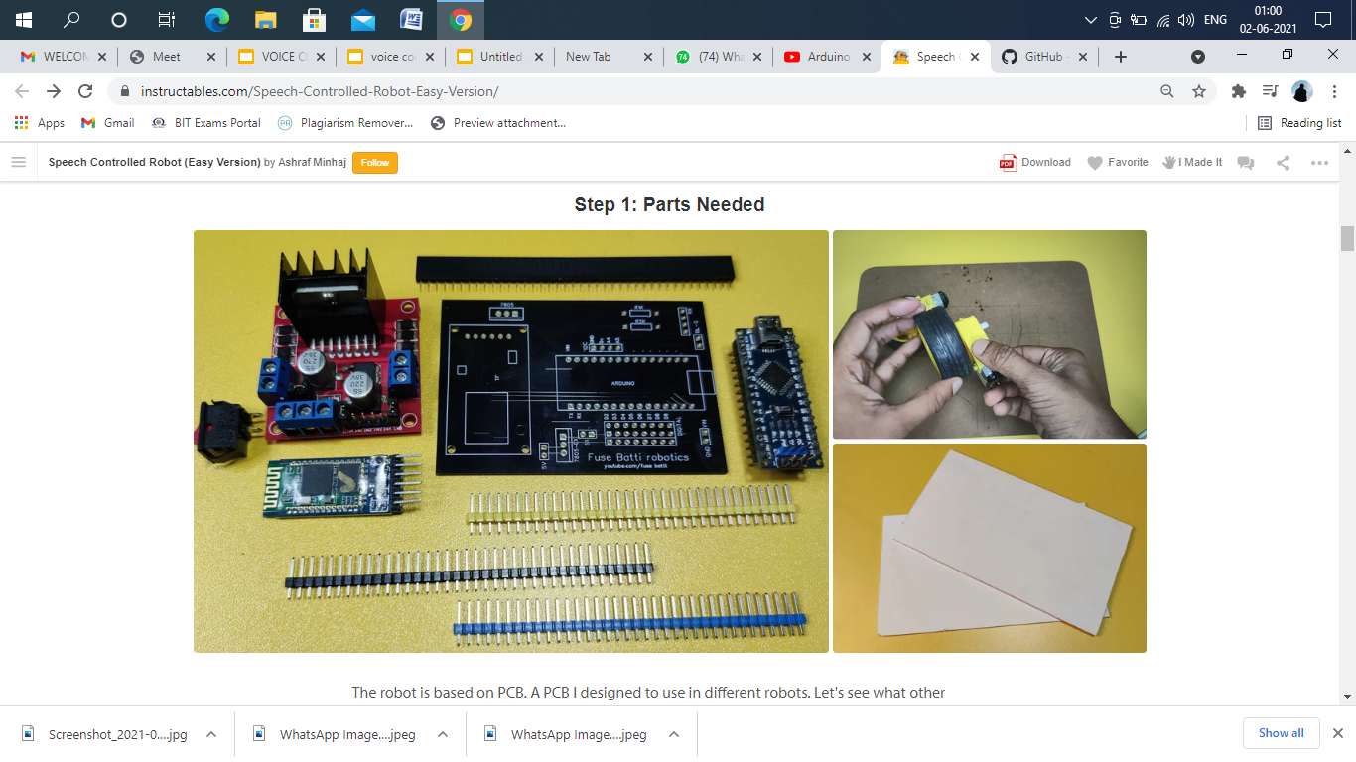
Material Requirement
Electronics:
Arduino
L298n Motor Driver module
Hc05 Bluetooth module
DC motor and compatible wheel
NRF24L01, HM2007
Some male and female headers
PVC Sheet (FOR BODY)

Slide 5
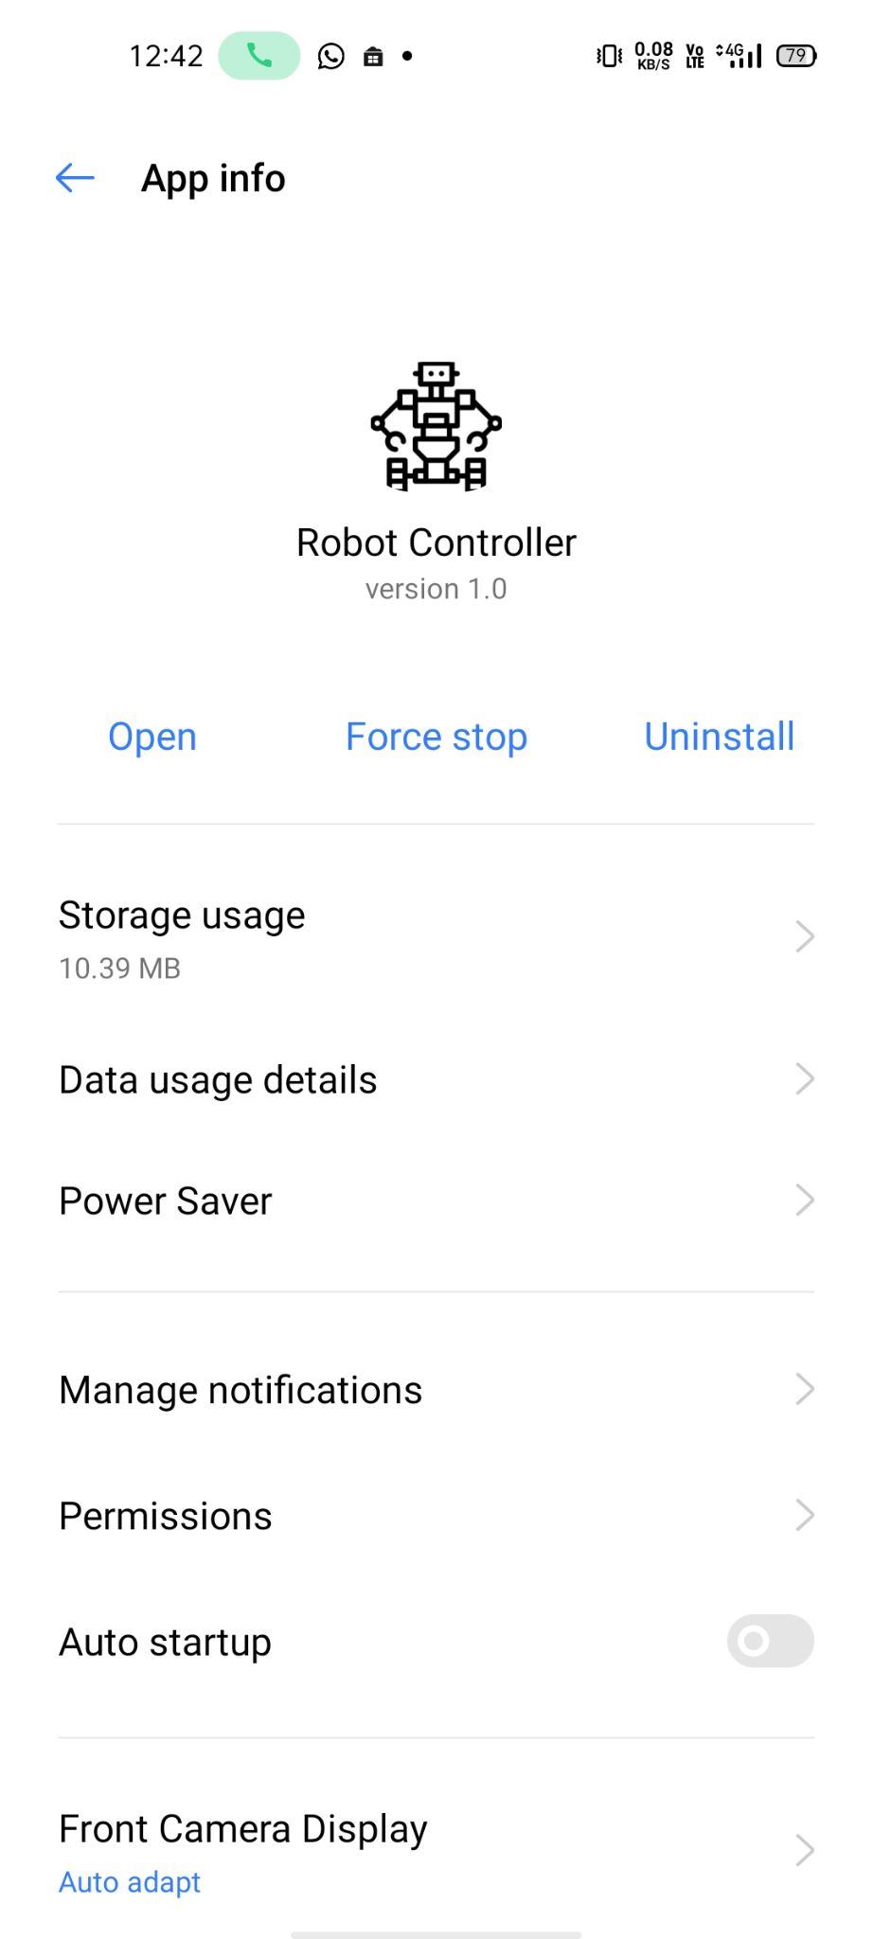
.
Software:
Arduino.ide
ROBOT CONTROLLER (ANDROID APP)

Slide 6
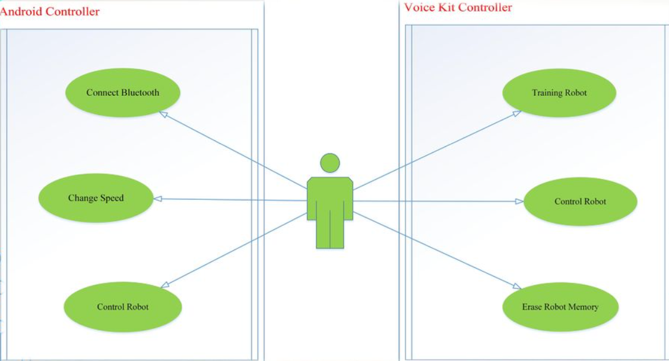
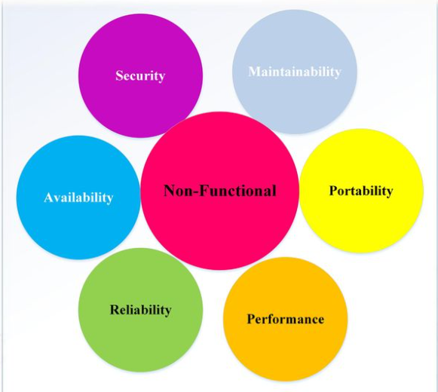
FUNCTION REQUIREMENT NON- FUNCTIONAL REQUIREMENT

Slide 7
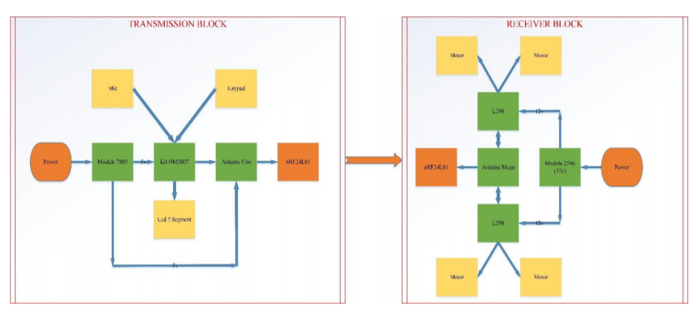
Voice Kit Control

Slide 8
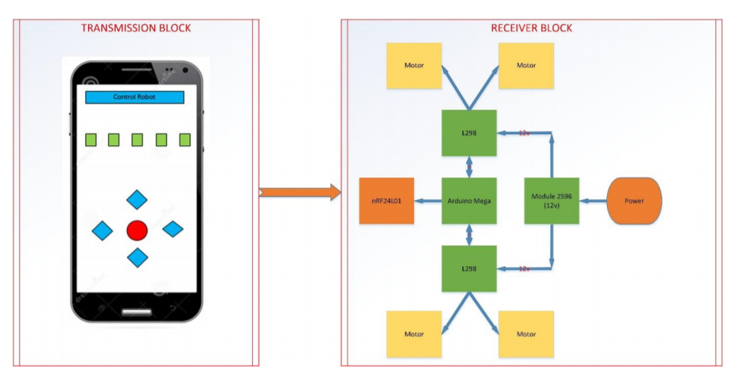
Android Controller

Slide 9
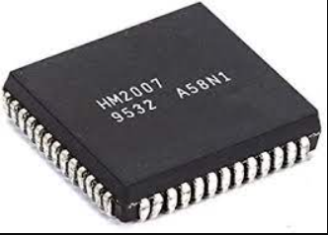
Voice Recognition
Speaker Dependent :
Recognition only for specific users.
Ex: IC HM2007
Speaker Independent :
Recognition for all users.
Ex: Google,Alexa,etc….

Slide 10
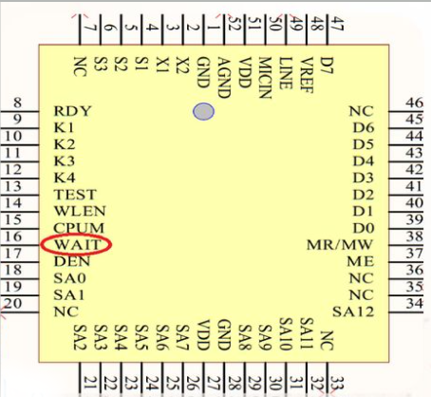
IC HM 2007 Pins
Waiting Control input:
Wait= “L” : Do not accept voice input.
Wait= “H” : Accept voice input.

Slide 11
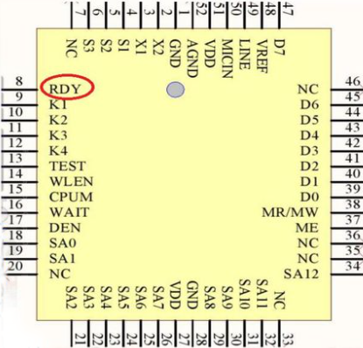
Work in manual mode
When wait= “H” ,RDY set to “L”:HM2007
is to accept the voice.
RDY return to “H” : HM2007 beings its
recognition process

Slide 12
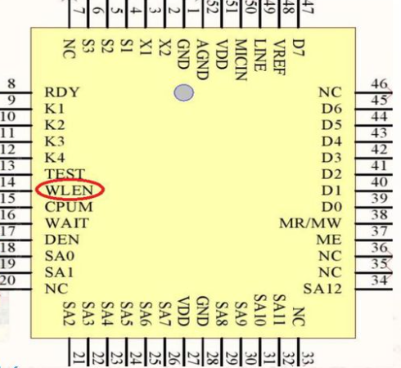
Word Length Select
WLEN= “H”:
Word length = 1.92 sec.
20 words maximum.
WLEN= “L”:
Word length = 0.92 sec.
40 words maximum.

Slide 13
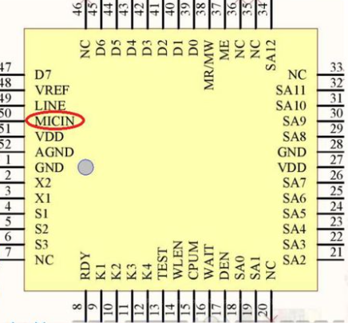
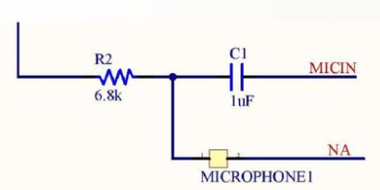
Microphone connect pin.
Connected: Capacitor and Resistor.
Low pass filter.

Slide 14
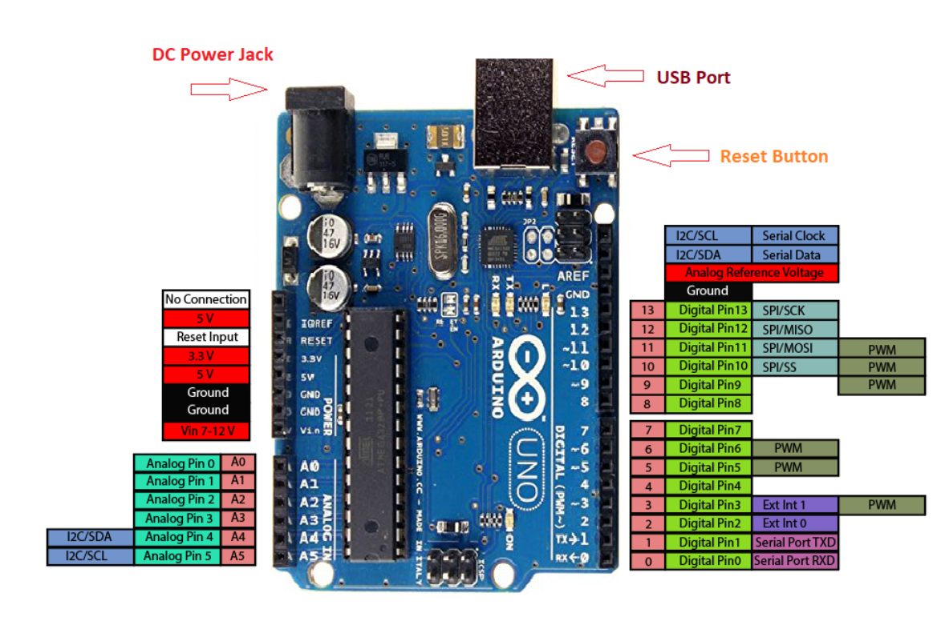
Arduino Uno

Slide 15
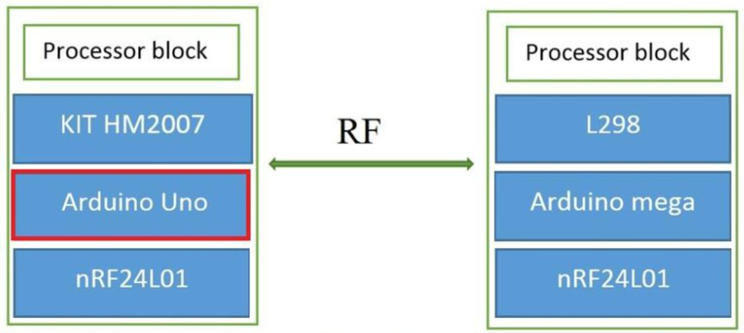

Slide 16
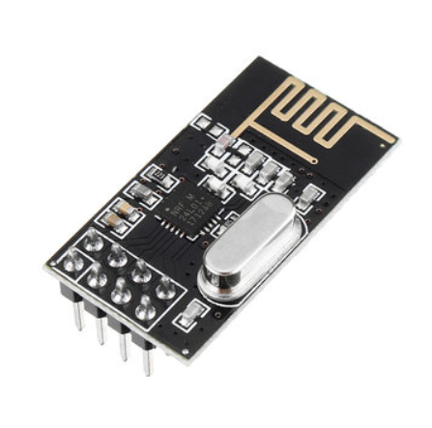
nRF24L01

Slide 17
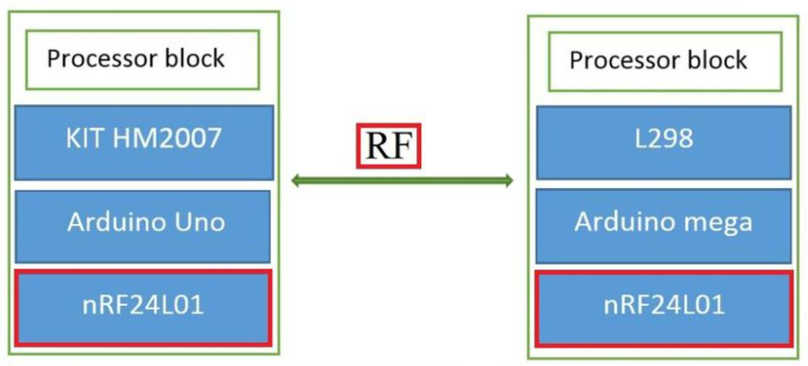

Slide 18
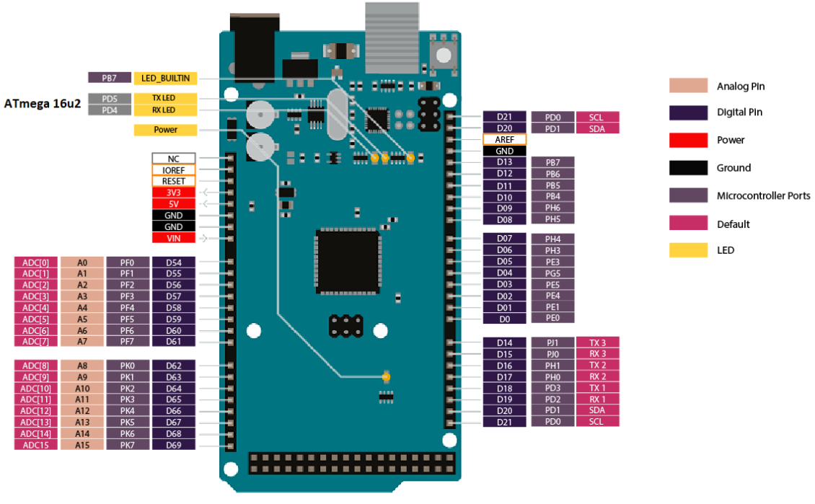
Arduino Mega

Slide 19
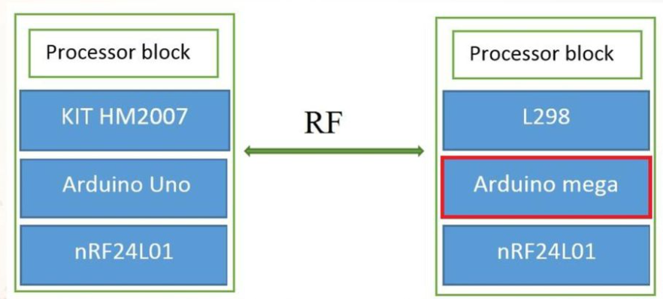

Slide 20
MOBILE APP
APP NAME : ROBOT CONTROLLER
CONTROLLER TYPE
BLUETOOTH CONTROL
VOICE CONTROL

Slide 21

Using Bluetooth Control

Slide 22
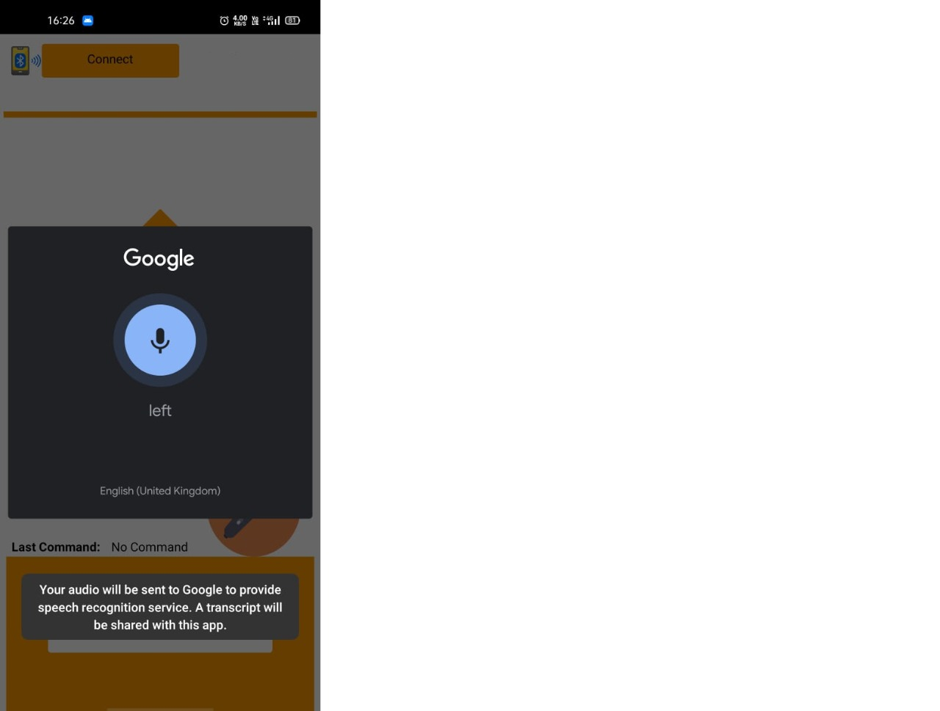
Using Voice Command

Slide 23
Working video Link
LINK - https://drive.google.com/file/d/1EcTvyFGbWX3TC0x9woz3lxyQFFD_CLUR/view?usp=sharing

Slide 24
THANK YOU

